Slide 1

PIP2001 Capstone Project
Review-0
CSD-G13 REAL TIME MAPPING OF EPIDEMIC SPREAD
Batch Number:
Roll Number | Student Name
20211CSD0038 | BHAVANA B N
20211CSD0005 | PRARTHANA S P
20211CSD0150 | SANCHIT A
20211CSD0042 | ULLAS GOWDA
Under the Supervision of,
Prof. Tintu Vijayan
Professor
School of Computer Science and Engineering
Presidency University
Name of the Program: B Tech
Name of the HoD: Dr. Saira Banu
Name of the Program Project Coordinator: Prof. Tintu Vijayan
Name of the School Project Coordinators: Dr. Sampath A K / Dr. Abdul Khadar A / Mr. Md Ziaur Rahman

Slide 2
Content
Problem Statement
Analysis of Problem Statement
Timeline of the Project
References

Slide 3
Problem Statement Number:
Organization: Thermo Fisher
Category (Hardware / Software / Both) : Software
Problem Description: We envision a simple portal which shall provide real time data on how an epidemic is and can spread. Real time status and alerts will be the primary objective of this project. To achieve this objective, we will need to build layers of crowd sourced data that will add up to provide rich real time status of an epidemic spread as it happens.
Difficulty Level: Complex

Slide 4
Problem Statement
In the face of emerging infectious diseases and recurrent epidemics, there is a critical need for real-time data to understand the spread of these diseases, facilitate timely interventions, and inform public health strategies.
Current epidemic tracking systems often lack integration of real-time,crowd-sourced data and predictive analytics, leading to gaps in situational awareness and delayed responses.
This project aims to develop a portal that provides a comprehensive, real-time mapping of epidemic spread by leveraging both official data sources and crowd-sourced information. The goal is to offer actionable insights into how an epidemic evolves, thereby supporting public health effortsand enhancing community awareness.

Slide 5
Analysis of Problem Statement
1. Need for Real-Time Data:
Current Challenges: Traditional epidemic tracking systems may rely on outdated information, leading to lag in response. Real-time data integration can address this issue by providing up-to-the-minute updates on disease spread.
Impact: Timely information can help in early detection of outbreaks, better resource allocation, and quicker implementation of public health measures.

Slide 6
Analysis of Problem Statement (contd..)
2. Integration of Crowd-Sourced Data:
Current Challenges: Limited use of crowd-sourced data due to concerns about accuracy and reliability. Traditional systems may not fully incorporate real-time, user-generated reports.
Impact: Effective integration can provide a more granular and immediate picture of disease spread, particularly in areas with limited official reporting.

Slide 7
Analysis of Problem Statement (contd..)
3. Predictive Analytics:
Current Challenges: Many systems lack advanced predictive models that can forecast future trends based on current data.
Impact: Predictive analytics can aid in planning and preparing for potential future outbreaks, allowing for proactive rather than reactive measures.

Slide 8
Analysis of Problem Statement (contd..)
4. Public Engagement and Education:
Current Challenges: Limited resources for public education and engagement during epidemics.
Impact: Providing accessible information and resources can improve public understanding and compliance with health recommendations.

Slide 9
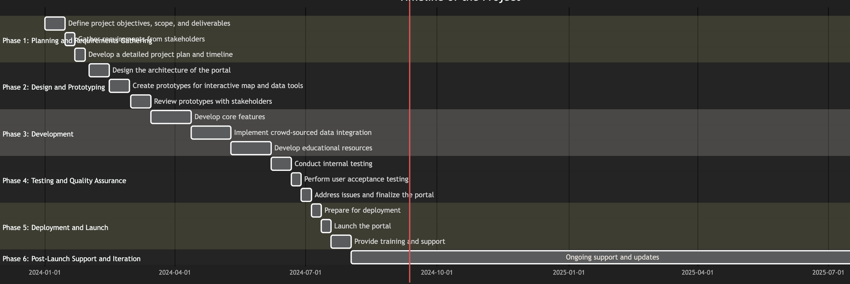
Timeline of the Project (Gantt Chart)

Slide 10
References (IEEE Paper format)
1. World Health Organization (WHO) - Epidemic and Pandemic Alert and Response
o World Health Organization. (n.d.). Epidemic and pandemic alert and response.
Retrieved September 11, 2024, from
https://www.who.int/emergencies/epidemics/en/
2. Centers for Disease Control and Prevention (CDC) - Disease Tracking
o Centers for Disease Control and Prevention. (n.d.). Disease tracking. Retrieved
September 11, 2024, from https://www.cdc.gov/ncezid/index.html

Slide 11
References (IEEE Paper format)
3. Johns Hopkins University. (n.d.). Coronavirus resource center. Retrieved September
11, 2024, from https://coronavirus.jhu.edu/map.html
4. GAVI - The Vaccine Alliance - Data and Insights
o GAVI, The Vaccine Alliance. (n.d.). Data and insights. Retrieved September 11, 2024,
from https://www.gavi.org/resources/infographics-and-data
5. PubMed - Research on Predictive Modeling in Epidemiology
o National Center for Biotechnology Information. (n.d.). PubMed. Retrieved
September 11, 2024, from https://pubmed.ncbi.nlm.nih.gov/

Slide 12


